Slide 1
Global Trade Spectrum using bokeh
By Gautam Matkar, Gagan Arora and Deepak Khirey

Slide 2

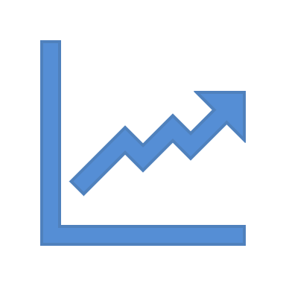


Motivation
Increase in merchandise trade | Global trade evolve over world map | Understand export and import relation | Granular information for WTO country | Understand intuition behind trade behavior
World merchandise exports increased to US$ 17.73 trillion in 2017, up from US$ 16.03 US trillion in 2016
World commercial services exports grew by 8% in 2017,reaching US$ 5.28 trillion
Asia was the top contributor to trade growth in volume terms in 2017
Notes:
Merchandise Trade in the modern world is typically driven by the difference in technology, re-
sources, demand, Existence of Government policies and the existence of economies of scale in pro-
duction. Merchandise trade [1] is characterized by merchandise exports and imports. Typically,
there are two systems to record merchandise trade referred to as general trade and special trade.
Special trade excludes certain trade flows. Merchandise trade is typically defined by general trade
which covers inward and outward flows of goods through country or territory. Goods are merchan-
dise which adds or reduces the stock of materials because of inward or outward flow through country
or territory. The flow of good is valued at transaction values [2]. The trade values can be a good
indicator of overall trade in International market, the trend for trade flows among developed and
developing countries, growth gap between various economies, trade shares of different economies[3].
We are proposing here to build a visualization that can illustrate merchandise trade transactions over
the years as per data collected by WTO. We describe our visualization as Global Trade Spectrum
as it will provide 360 views of all transactions in different categories of trades.The data is visu-
alized by 3 different charts-Line chart,GeoMap and Heatmap covering aspects of trending,display
of worldmap and identify data patterns providing understanding of evolution of Global trade and
factors influencing it since 1947.Bokeh was used to visualize the charts as it provides elegant and
concise mechanism to plot highly complex chart and figure.
Reference
[1] Nicita, A. (2014). United Nations Conference on Trade and Development. UNITED NATIONS PUBLICATION. Geneva 10, Switzerland: UNITED NATIONS CONFERENCE ON TRADE AND DEVELOPMENT.
[2] World Trade Organization . (2019). WTO Statistical data sets - Metadata. Retrieved from http://stat.wto.org: http://stat.wto.org/StatisticalProgram/WSDBStatProgramTechNotes.aspx?Language=E#Data_availability
[3] World Trade Organization. (2018). Latest trends in world trade 2017-2018. World Trade Statistical Review , 28-39.
[4] World Trade Organization. (2019). Bulk download of trade datasets. Retrieved from www.wto.org: https://www.wto.org/english/res_e/statis_e/trade_datasets_e.htm
[5] World Trade Organization. (2019). Statistics on merchandise trade. Retrieved from www.wto.org: https://www.wto.org/english/res_e/statis_e/merch_trade_stat_e.html
[6] World Trade Organization. (2019). Country Analysis. Retrieved from wits.worldbank.org: http://wits.worldbank.org/visualization/country-analysis-visualization.html

Slide 3
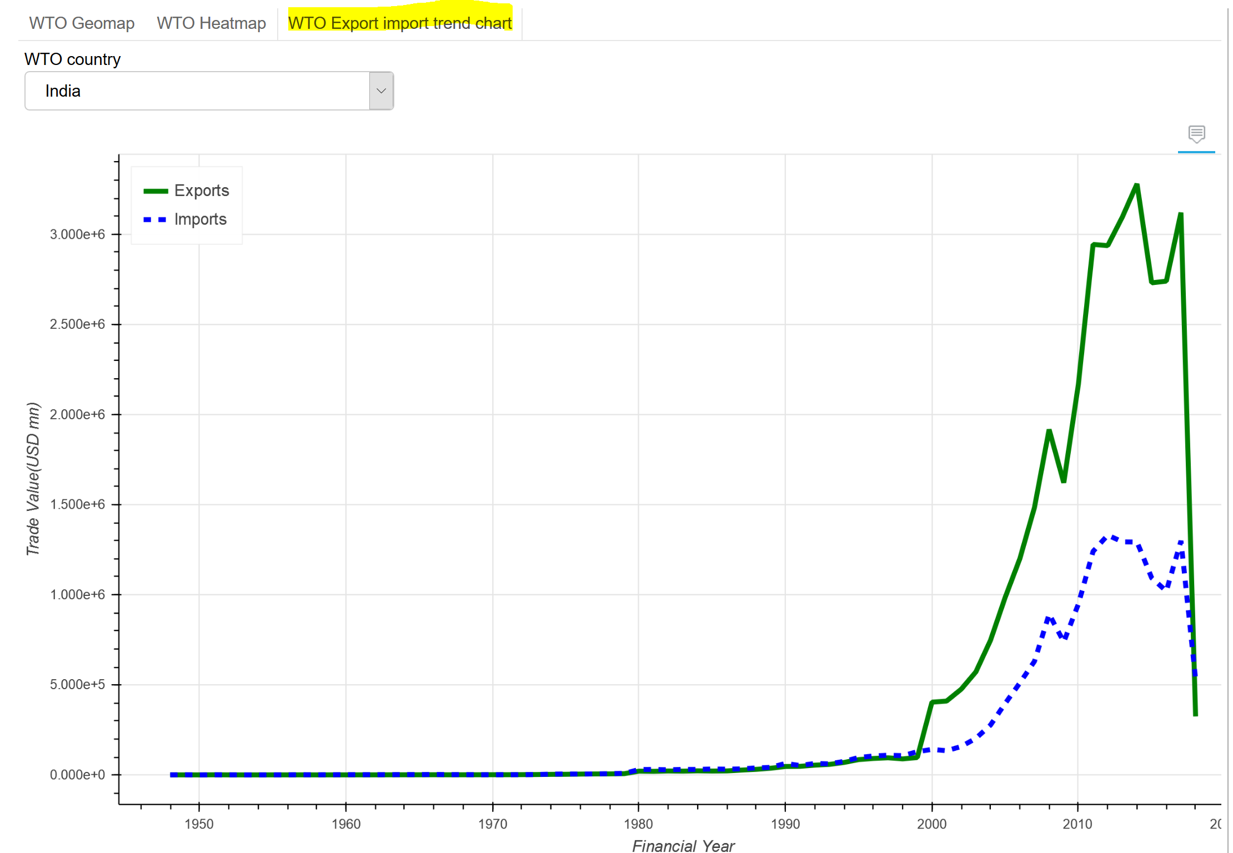
Dashboard - TrendChart
How Export and Import trend over period of time?
Built using Bokeh
Y-axis defines trade values in million dollars
X-axis defines financial years

Slide 4
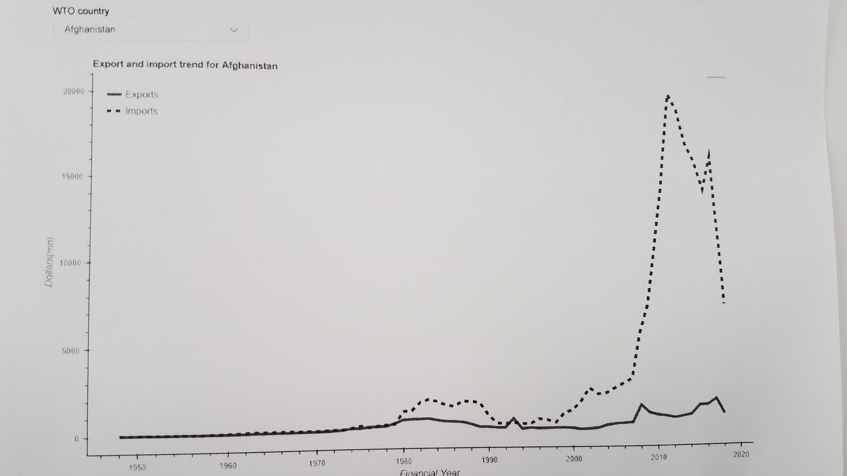
TrendChart after Printout
Legends
Ease of readability after Print out

Slide 5
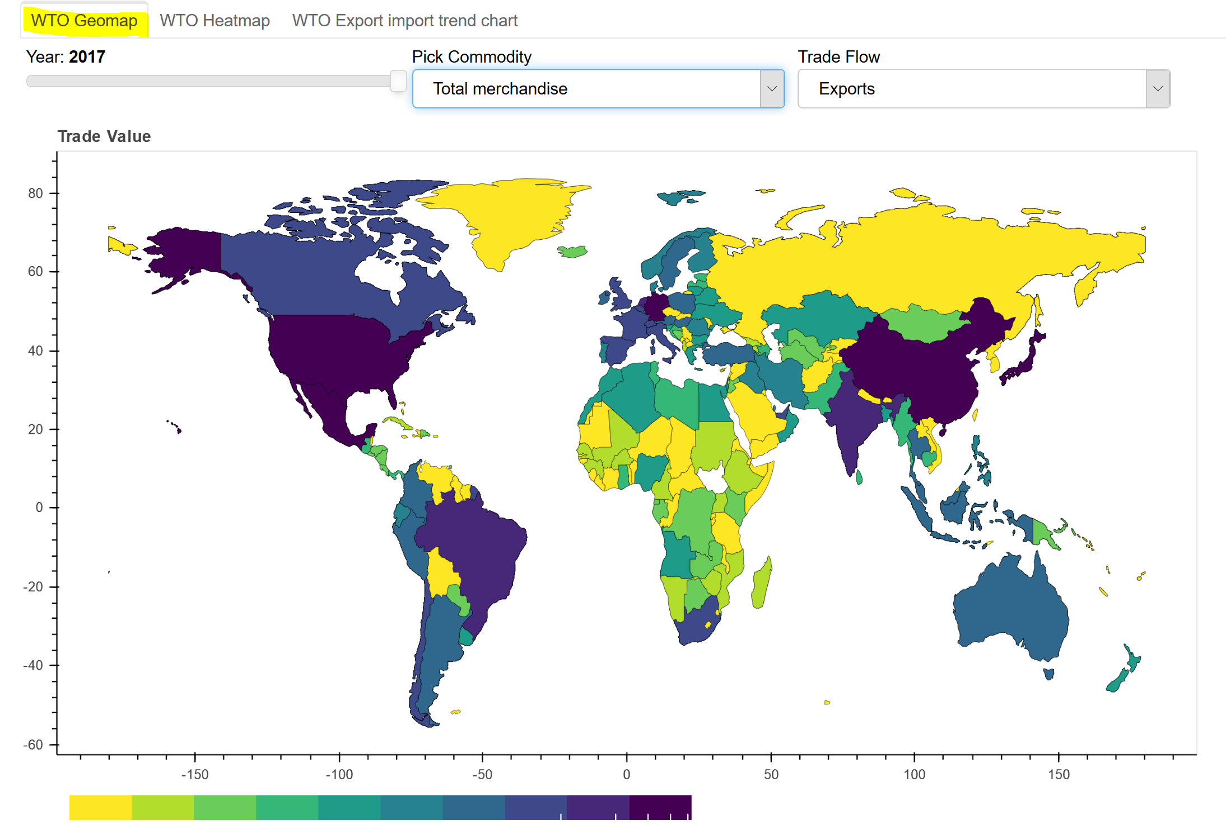
Dashboard - GeoMap

Slide 6
Why Heatmap ?
Geomap can not show Economic groups such as EURO, ASEAN, OPEC etc.
Heatmap can provide most granular details of dataset in an Interactive manner
Heatmap can provide Country’s Economic status at a glance
We can see Export and Import transactions side-by-side
Heatmap shows all Trade categories in same plot

Slide 7
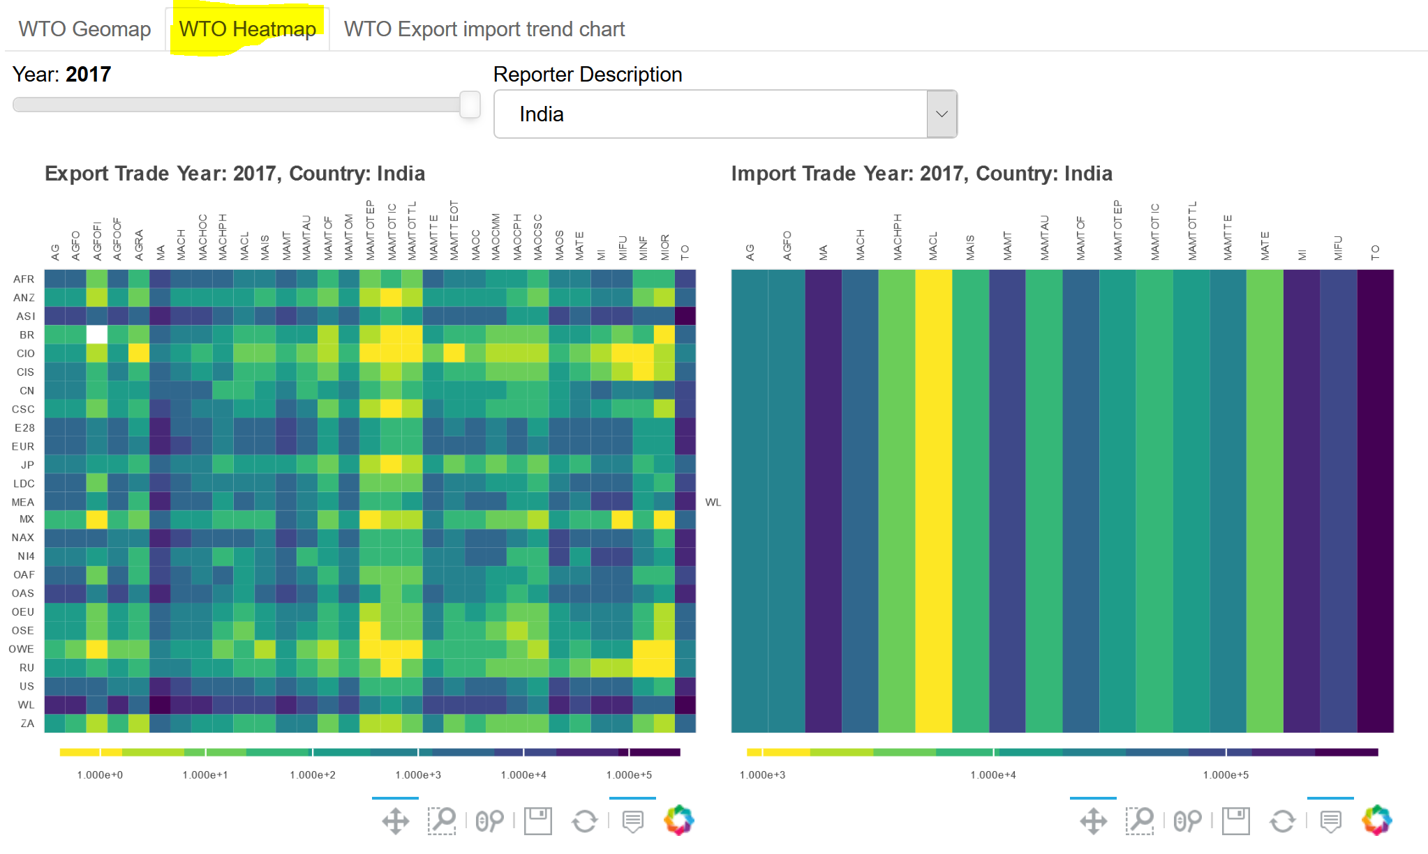
Dashboard - HeatMap

Slide 8
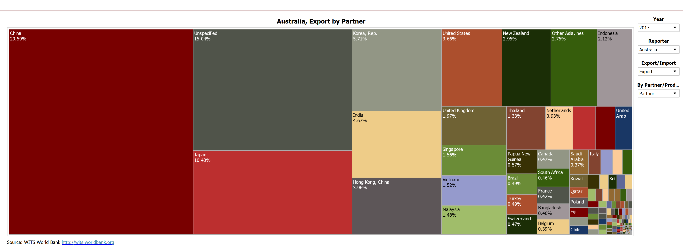
Related Work
Missing Geographical element
Can not visualize the trade patterns over years
Hard to visualize which commodity contributes to what trade: export/import
Boxes get small and hard to read on the bottom right of the chart.

Slide 9

Research Question/ Objective
Analyze WTO merchandise trade values annual dataset.
Visualize the data and indicate the trade pattern.
Distinguish indicator for trade expansion, political policies, trade events.
Visualize the impact of historical events such as recession of 2008, 911 terror attack, Arab spring etc.

Slide 10
Conclusion
It is very tedious to create multiple plots for given dataset like WTO Merchandise Trade
It will be very inefficient way to create separate plots for each country or each trade category
Hence it is very useful to create interactive plots where visualization updates based on user selection
Bokeh provides very robust Interactive Dashboard capabilities to explore data visually
Different visualization methods like Line Chart, Geomap, Heatmap are useful to convey different properties of dataset like Temporal Trends, Regional co-operation etc.

Slide 11

Future Work
In current work, interactive behavior is possible only when we start bokeh server
For future, we could host the bokeh python app on the web server
Flask: Micro web framework for Python
Pythonanywhere: Web hosting for the Flask app
We could also create an animation which could depict trade transaction from 1947 till 2017

Slide 12
References
[1] W. T. Notes, Nicita, a. (2014). united nations confer-ence on trade and development. united nations publica-
tion. geneva 10, switzerland: United nations conferenceon trade and development. (2019).
[2] W. T. Organizations, World trade organization . (2019).wto statistical data sets - metadata. (2019).
[3] W. T. Organizations, World trade organization. (2018).latest trends in world trade 2017-2018. world trade sta-
tistical review , 28-39. (2019).
[4] W. T. Organizations, Bulk download of trade datasets.retrieved from www.wto.org: (2019).
[5] W. T. Organizations, Statistics on merchandise trade.retrieved from www.wto.org: (2019).
[6] W. T. Organizations, Country analysis. retrieved from wits.worldbank.org: (2019).
[7] W. T. Organizations, Detailed product analysis. Retrieved from wits.worldbank.org: (2019).
[8] W. T. Organizations, Merchandise trade balance with partners. retrieved from wits.worldbank.org: (2019).
[9] W. T. Organizations, World integrated trade solution. retrieved from wits.worldbank.org: (2019).

Slide 13
Thank You!
Data Visualization is Fun!!!!!!!!!!!!!!!!!!!!!

